Slide 1
Design Presentation: Data Loading & Data Lake Organization
Owner: Sean Norman
CSA03P | 1 of 2
Session Day/Time: | Day 1, Ingest & Transform: 09:00 – 10:00 | Presenters/SMEs: | Presenter: John Doe SME(s): John Doe; Jane Doe
Virtual Format and Software: | Presentation: Single Speaker Presenter, ppt slide presentation, live virtual broadcast via Teams, chat enabled and moderated
Cohort / Breakout Mgmt | No cohorts / breakout activities during this session
Objective of Session: | As a result of attending this, attendees will better be able to…
Existing Sources: | <link to any supporting content sources (if any)>
Learner Content: | <Link to draft ppt slide deck and any other materials that the attendees would be seeing or using as part of this session>
Presenter/ SME Guide Content: | <Link to any supporting materials that are just for the presenter and/or supporting SMEs>
Required Homework + name of session for HW review: | No homework or pre-required content needed for this session

Slide 2
Design Presentation: Data Loading & Data Lake Organization
Owner: Sean Norman
CSA03P | 2 of 2
Session Flow and Detailed Agenda |  | Presenter/SME: | Time
Prework | No attendee pre-work needed for this session | N/A | N/A
Session Introduction | Set context for when this process takes place | <presenter> | 3 mins
Body of the session / discussion, activities, Q&A... | Copy Pipelines DataFrame Data Lake Organization Gold, silver, bronze tiers of raw data refinement Best practices - loading on prem data & landing to Azure Best practices - cloud data Best practices - file data sources Ingestion - Polybase vs Copy (Preferred) Ingestion - Table optimization Ingestion - CCI vs Heap | <presenter> | 25 mins
Session Closing / Homework | Go to break Review timing for break, remind audience to stay signed into the meeting, when session will resume, and what they will be doing next. (Data Loading & Data Lake Organization) | <presenter> | 2 mins

Slide 3
Topics Covered
Copy Pipelines Data Lake Organization Gold, silver, bronze tiers of raw data refinement Best practices - loading on prem data & landing to Azure Best practices - cloud data Best practices - file data sources Ingestion - Polybase vs Copy (Preferred) Ingestion - Table optimization Ingestion - CCI vs Heap

Slide 4
Data Loading & Data Lake Organization
CSA03P

Slide 5

Agenda
1 Orchestration
Synapse pipelines
2 Ingest files to tables
Copy versus CTAS
3 Best practices
Various ingest and storage best practices

Slide 6

Azure Synapse Analytics
Limitless analytics service with unmatched time to insight
Artificial Intelligence / Machine Learning / Internet of Things
Intelligent Apps / Business Intelligence
Designed for analytics workloads at any scale
Synapse Analytics
SaaS developer experiences for code free and code first
Experience
Azure Synapse Studio
Platform
Multiple languages suited to different analytics workloads
MANAGEMENT
Languages
MANAGEMENT
SQL
Python
.NET
Java
Scala
R
Integrated analytics runtimes available provisioned and serverless on-demand
SQL Analytics offering T-SQL for batch, streaming and interactive processing
Spark for big data processing with Python, Scala, R and .NET
SECURITY
Form Factors
SECURITY
PROVISIONED
SERVERLESS
MONITORING
Analytics Runtimes
MONITORING
SQL
METASTORE
METASTORE
DATA INTEGRATION
Integrated platform services for, management, security, monitoring, and metastore
Azure
Data Lake Storage
Common Data Model
Enterprise Security
Optimized for Analytics
Data lake integrated and Common Data Model aware

Slide 7
Modern Data Warehouse
INGEST
PREPARE
TRANSFORM & ENRICH
SERVE
VISUALIZE
STORE

Slide 8
Ingest - Orchestration with Pipelines

Slide 9



Components of Orchestration
Trigger
Pipeline
foreach (…)
On demand
Schedule
Data Window
Event
Activity
Activity
Activity
Activity
Activity
Self-hosted
Integration Runtime
Azure
Integration Runtime
Linked
Service
LEGEND
On-prem
Apps & Data
Azure Services
Command and Control
Data

Slide 10
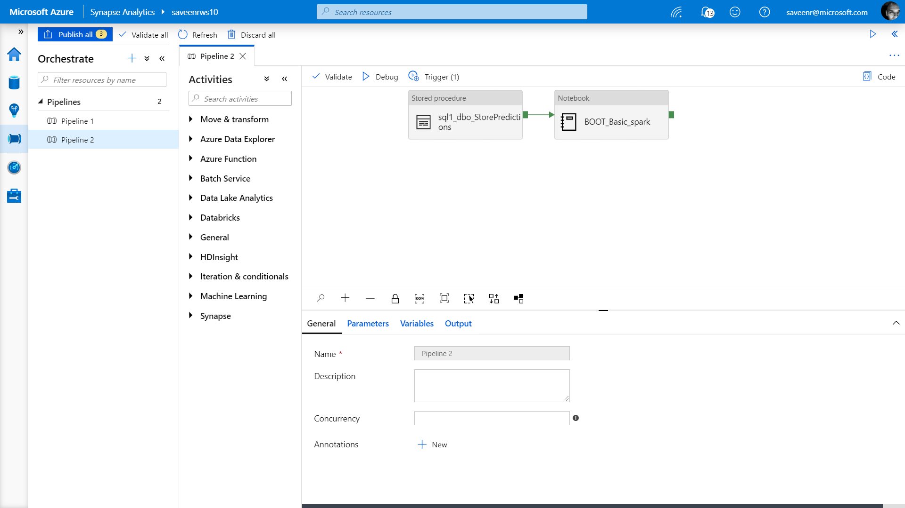
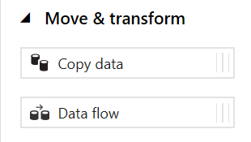
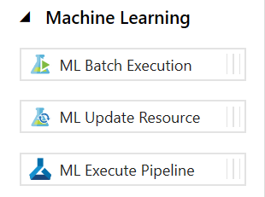
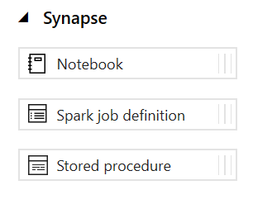
Pipelines
Create pipelines to ingest, transform and load data with 90+ inbuilt connectors.
Offers a wide range of activities that a pipeline can perform.

Slide 11
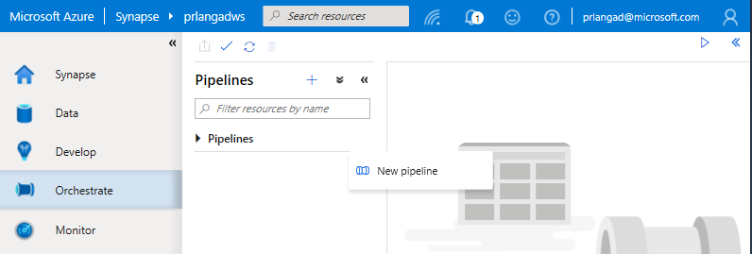
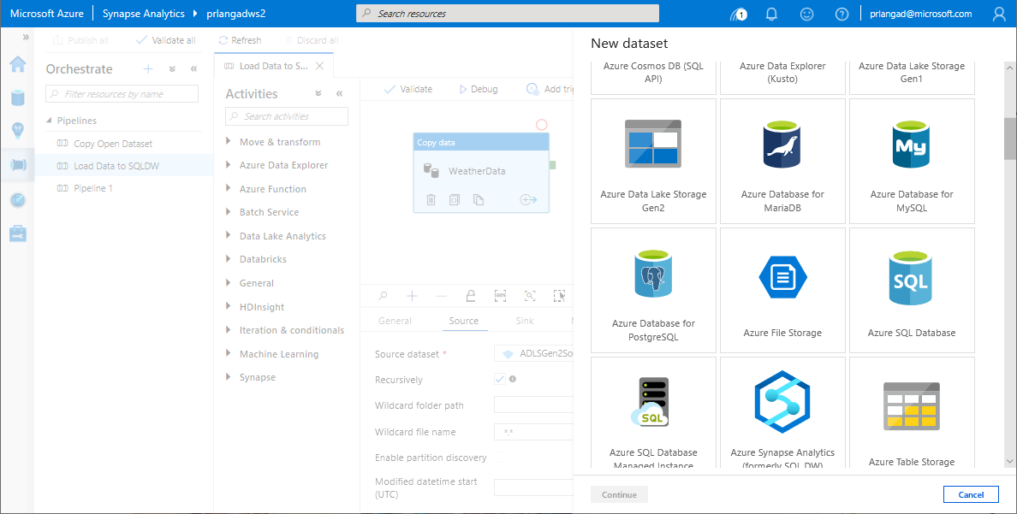
Pipelines
Overview
Provide ability to load data from storage account to desired linked service.
Load data by manual execution of pipeline or by orchestration.
Benefits
Supports common loading patterns.
Fully parallel loading into data lake or SQL tables.
Graphical development experience.

Slide 12
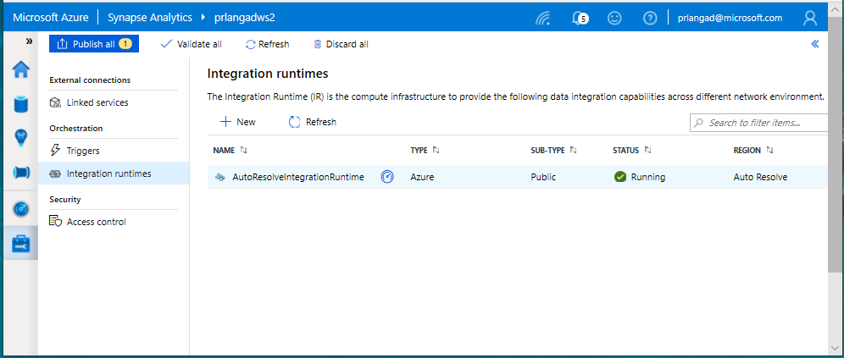
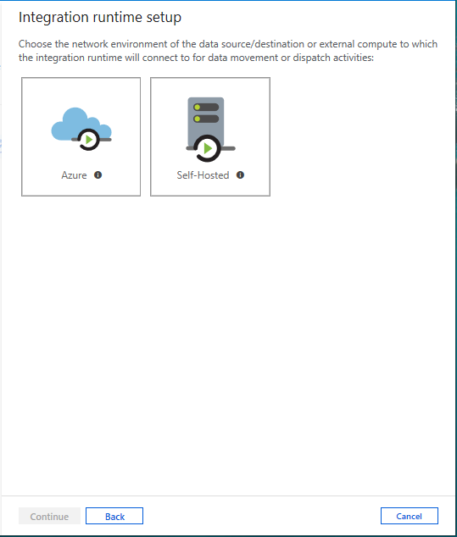
Integration runtimes
Overview
Integration runtimes are the compute infrastructure used by Pipelines to provide the data integration capabilities across different network environments. An integration runtime provides the bridge between the activity and linked services.
Benefits
Offers Azure Integration Runtime or Self-Hosted Integration Runtime
Azure Integration Runtime – provides fully managed, serverless compute in Azure
Self-Hosted Integration Runtime – use compute resources in on-premises machine or a VM inside private network
Notes:
Need to explain and why needed
Check with Gaurav

Slide 13
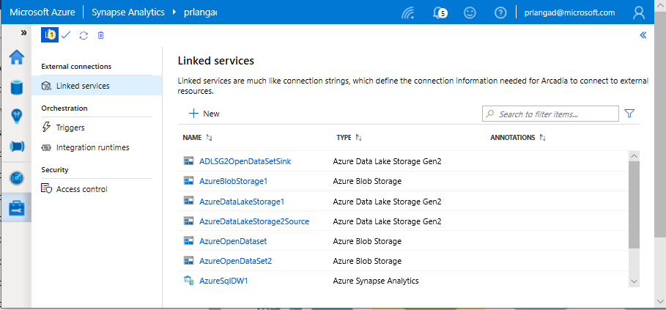
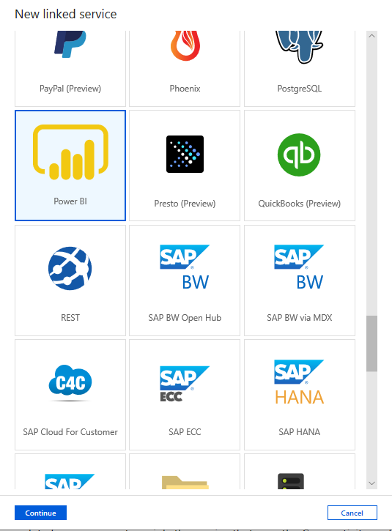
Linked services
Overview
Linked services define the connection information needed to connect to external resources.
Benefits
Offers pre-build 90+ connectors
Easy cross platform data migration
Represents data store or compute resources

Slide 14
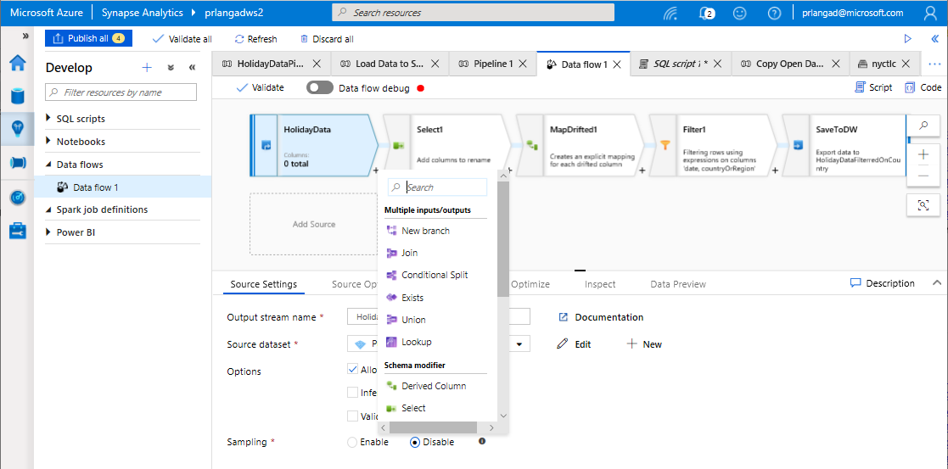
Data Flows
Data flows are pipeline activities providing a visual way of specifying how to transform data.
Provides a code-free experience.

Slide 15
Dataflow Capabilities
Azure Synapse Analytics > Studio > Develop
Handle upserts, updates, deletes on sql sinks
Add new partition methods
Add schema drift support
Add file handling (move files after read, write files to file names described in rows etc)
New inventory of functions (for e.g Hash functions for row comparison)
Commonly used ETL patterns(Sequence generator/Lookup transformation/SCD…)
Data lineage – Capturing sink column lineage & impact analysis(invaluable if this is for enterprise deployment)
Implement commonly used ETL patterns as templates(SCD Type1, Type2, Data Vault)

Slide 16
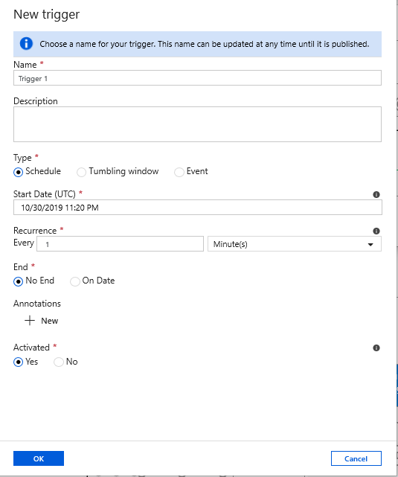
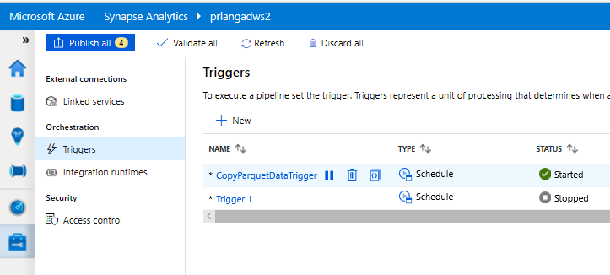
Triggers
Overview
Triggers represent a unit of processing that determines when a pipeline execution needs to be kicked off.
Data Integration offers 3 trigger types as –
Schedule – gets fired at a schedule with information of start date, recurrence, end date
Event – gets fired on specified event
Tumbling window – gets fired at a periodic time interval from a specified start date, while retaining state
It also provides ability to monitor pipeline runs and control trigger execution.

Slide 17
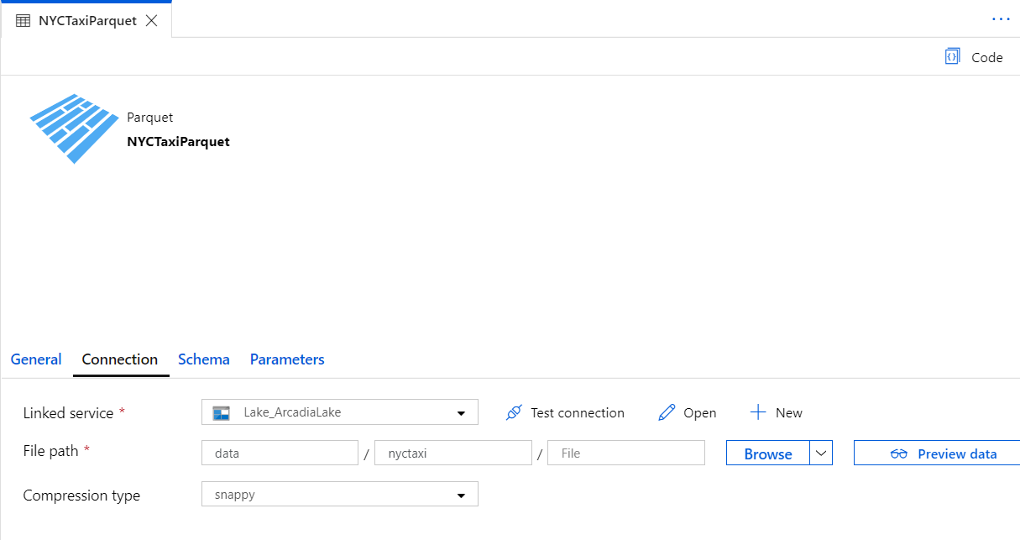
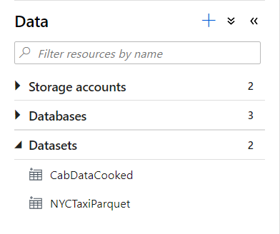
Datasets
Orchestration datasets describe data that is persisted. Once a dataset is defined, it can be used in pipelines and sources of data or as sinks of data.

Slide 18







Data Movement
Scalable
per job elasticity
Up to 4 GB/s
Simple
Visually author or via code (Python, .Net, etc.)
Serverless, no infrastructure to manage
Access all your data
90+ connectors provided and growing (cloud, on premises, SaaS)
Data Movement as a Service: 25 points of presence worldwide
Self-hostable Integration Runtime for hybrid movement

Slide 19
90+ Connectors out of the box
Azure (15) | Database & DW (26) |  | File Storage (6) | File Formats(6) | NoSQL (3) | Services and App (28) |  | Generic (4)
Blob storage | Amazon Redshift | Oracle | Amazon S3 | AVRO | Cassandra | Amazon MWS | Oracle Service Cloud | Generic HTTP
Cosmos DB - SQL API | DB2 | Phoenix | File system | Binary | Couchbase | CDS for Apps | PayPal | Generic OData
Cosmos DB - MongoDB API | Drill | PostgreSQL | FTP | Delimited Text | MongoDB | Concur | QuickBooks | Generic ODBC
Data Explorer | Google BigQuery | Presto | Google Cloud Storage | JSON |  | Dynamics 365 | Salesforce | Generic REST
Data Lake Storage Gen1 | Greenplum | SAP BW Open Hub | HDFS | ORC |  | Dynamics AX | SF Service Cloud
Data Lake Storage Gen2 | HBase | SAP BW via MDX | SFTP | Parquet |  | Dynamics CRM | SF Marketing Cloud
Database for MariaDB | Hive | SAP HANA |  |  |  | Google AdWords | SAP C4C
Database for MySQL | Apache Impala | SAP table |  |  |  | HubSpot | SAP ECC
Database for PostgreSQL | Informix | Spark |  |  |  | Jira | ServiceNow
File Storage | MariaDB | SQL Server |  |  |  | Magento | Shopify
SQL Database | Microsoft Access | Sybase |  |  |  | Marketo | Square
SQL Database MI | MySQL | Teradata |  |  |  | Office 365 | Web table
SQL Data Warehouse | Netezza | Vertica |  |  |  | Oracle Eloqua | Xero
Search index |  |  |  |  |  | Oracle Responsys | Zoho
Table storage
Notes:
formatting

Slide 20
Ingesting files into tables

Slide 21
COPY command
COPY INTO test_1
FROM 'https://XXX.blob.core.windows.net/customerdatasets/test_1.txt'
WITH (
FILE_TYPE = 'CSV',
CREDENTIAL=(IDENTITY= 'Shared Access Signature', SECRET='<Your_SAS_Token>'),
FIELDQUOTE = '"',
FIELDTERMINATOR=';',
ROWTERMINATOR='0X0A',
ENCODING = 'UTF8',
DATEFORMAT = 'ymd',
MAXERRORS = 10,
ERRORFILE = '/errorsfolder/'--path starting from the storage container,
IDENTITY_INSERT
)
Overview
Copies data from source to destination
Benefits
Retrieves data from all files from the folder and all its subfolders.
Supports multiple locations from the same storage account, separated by comma
Supports Azure Data Lake Storage (ADLS) Gen 2 and Azure Blob Storage.
Supports CSV, PARQUET, ORC file formats
COPY INTO test_parquet
FROM 'https://XXX.blob.core.windows.net/customerdatasets/test.parquet'
WITH (
FILE_FORMAT = myFileFormat
CREDENTIAL=(IDENTITY= 'Shared Access Signature', SECRET='<Your_SAS_Token>')
)

Slide 22
Create External Table As Select (Polybase)
-- Create a database master key if one does not already exist
CREATE MASTER KEY ENCRYPTION BY PASSWORD = 'S0me!nfo'
;
-- Create a database scoped credential with Azure storage account key as the secret.
CREATE DATABASE SCOPED CREDENTIAL AzureStorageCredential
WITH
IDENTITY = '<my_account>'
, SECRET = '<azure_storage_account_key>'
;
-- Create an external data source with CREDENTIAL option.
CREATE EXTERNAL DATA SOURCE MyAzureStorage
WITH
( LOCATION = 'wasbs://daily@logs.blob.core.windows.net/'
, CREDENTIAL = AzureStorageCredential
, TYPE = HADOOP
)
-- Create an external file format
CREATE EXTERNAL FILE FORMAT MyAzureCSVFormat
WITH (FORMAT_TYPE = DELIMITEDTEXT,
FORMAT_OPTIONS(
FIELD_TERMINATOR = ',',
FIRST_ROW = 2)
--Create an external table
CREATE EXTERNAL TABLE dbo.FactInternetSalesNew
WITH(
LOCATION = '/files/Customer',
DATA_SOURCE = MyAzureStorage,
FILE_FORMAT = MyAzureCSVFormat
)
AS SELECT T1.* FROM dbo.FactInternetSales T1 JOIN dbo.DimCustomer T2
ON ( T1.CustomerKey = T2.CustomerKey )
OPTION ( HASH JOIN );
Overview
Creates an external table and then exports results of the Select statement. These operations will import data into the database for the duration of the query
Steps:
Create Master Key
Create Credentials
Create External Data Source
Create External Data Format
Create External Table

Slide 23
Polybase vs Copy
Polybase
GA, stable
Needs CONTROL permission
Fastest (at present)
Challenges:
Row width
Delimiters in text
Fixed line delimiter
Code complexity
COPY
Currently in Preview
Relaxed permission
Slightly slower, but improving
No row width limit
Supports delimiters in text
Supports custom column and row delimiters

Slide 24
Best Practices for Ingest

Slide 25
Ingest Flat files to tables
Ingest flat file data into Azure Storage (Azure Data Lake Store Gen2)
When your data sources are on-premises, you need to move the data to Azure Storage before ingestion.
Data in other cloud platforms needs to be moved to Azure Storage before ingestion.
Load from flat files as relational tables within the data warehouse
Notes:
What specific approach would you say is the most efficient way for moving flat file data from the ingest storage locations to the data lake?
Follow the pattern of landing data in the data lake first, then ingest from the flat files into relational tables within the data warehouse. Then create pipelines that extract the source data and store in Azure Data Lake Store Gen2 as Parquet files.
What storage service would you recommend to use?
They should use Azure Data Lake Store (ADLS) Gen2 (Azure Storage with hierarchical file systems).

Slide 26
Ingest - Structuring ADLS Gen2
Separate storage accounts for each environment: dev, test, & production.
Use a common folder structure to organize data by degree of refinement.
ADLS Gen 2 Filesystem
Raw Data
/bronze
Query Ready
/silver
Report Ready
/gold
Notes:
How would you recommend to structure the folder to manage the data at the various levels of refinement?
They should use Azure Data Lake Store (ADLS) Gen2 (Azure Storage with hierarchical file systems).
In ADLS, it is a best practice to have a dedicated Storage Account for production, and a separate Storage Account for dev and test workloads. This will ensure that dev or test workloads never interfere with production.
One common folder structure is to organize the data in separate folders by degree of refinement. For example a bronze folder contains the raw data, silver contains the cleaned, prepared and integrated data and gold contains data ready to support analytics, which might include final refinements such as pre-computed aggregates.

Slide 27
Ingest from on-premises data sources
Fastest is done by batch:
Extract from data source to multiple CSV/Parquet files
Use AzCopy to upload to ADLS
Alternative is query-insert:
Set up SSIS self-hosted integration runtime on-premises
Use Synapse Pipeline to extract/copy
Use Synapse Pipeline to execute load procedure
Large Migrations:
Use Azure Data Box where available

Slide 28
Ingest from Cloud Data Sources
Options:
Extract using Synapse Pipelines
Write to ADLS as Parquet files
AzCopy is a fast move for files from S3 to ADLS

Slide 29
Ingest File Data Sources
File format challenges to look out for:
Invalid file format
Multiple row types
Ragged columns
Row size > 1Mb
Datetime format/s (e.g., use of nanosecond date time)
NULL value literal/s
Free form text
Parquet partitions
XML data
Use of non-standard line delimiters (e.g., CR)
Solutions
Use Spark to pre-process and fix data errors
Flatten and parse XML in Spark
Use COPY to ingest complex CSV instead of Polybase

Slide 30
Ingest and Store – Formats
For batch flat files, Azure Synapse Analytics supports CSV, Parquet, ORC, and JSON formats.
Ingest streaming data messages/events via Event Hub or IoT Hub.
Parquet format recommended for storing ingested data at various levels of refinement.
Notes:
When it comes to ingesting raw data in batch from new data sources, what data formats are supported by Synapse?
CSV, Parquet, ORC, JSON
How do you ingest streaming data?
Collect messages in Event Hub or IoT Hub and process them with Stream Analytics.
Azure offers purpose-built stream ingestion services such as Azure Kafka and Azure Event Hubs that are robust, proven and performant.
(Preview) Azure Synapse will also support native stream ingestion through integration with Azure Stream Analytics.
When it comes to storing refined versions of the data for possible querying, what data format would you recommend they use? Why?
Parquet. There is industry alignment around the Parquet format for sharing data at the storage layer (e.g., across Hadoop, Databricks, and SQL engine scenarios). Parquet is a high-performance, column oriented format optimized for big data scenarios.

Slide 31
Ingest - When to BCP / Bulk Copy
Green fields: Never
Network unreliability, no retries
Needs VM in cloud, performance dependent on VM configuration
Doesn’t support ADLS
Reduces concurrency
Control-gated performance limitation, can not scale with DWU
Migrations:
Use Synapse Pipeline or AzCopy
Bulk Copy will work, but it will be slower than other methods

Slide 32
Ingest – Synapse Pipelines
Un-check USE TYPE DEFAULT, it is not a best practice.
Land data in ADLS Gen2, then ingest using Polybase / COPY.
This means you can re-ingest the same data set without having to repeat extracts, and better demonstrate ingestion performance.

Slide 33
Ingest and Store – Loading staging tables
Indexing
Use Heap tables
Speed load performance by staging data in heap tables and temporary tables prior to running transformations.
Only load to a CCI table if the test requires a load to a single table, then complex end-user queries against that table.
as
Notes:
What should you use for the fastest loading of staging tables?
A heap table. If you are loading data only to stage it before running more transformations, loading the table to heap table is much faster than loading the data to a clustered columnstore table.
A temporary table. Loading data to a temporary table loads faster than loading a table to permanent storage.

Slide 34
Ingest and Store – Loading staging tables
Distribution
Use Round Robin Distribution for:
Potentially useful tables created from raw input.
Temporary staging tables used in data preparation.
Other distribution considerations:
Never load to a REPLICATED table
Load to a ROUND_ROBIN table if the test is ONLY raw ingestion performance, or if the table is very small
Load to a HASH table if the test is a pipeline with subsequent transformations using the loaded table
Notes:
How should you configure table distribution for tables created from the raw input that might be useful, or tables used for staging?
Consider round-robin distribution.
A round-robin distributed table distributes table rows evenly across all distributions. The assignment of rows to distributions is random. Unlike hash-distributed tables, rows with equal values are not guaranteed to be assigned to the same distribution.
As a result, the system sometimes needs to invoke a data movement operation to better organize your data before it can resolve a query. This extra step can slow down your queries. For example, joining a round-robin table usually requires reshuffling the rows, which is a performance hit.
Consider using the round-robin distribution for your table in the following scenarios:
When getting started as a simple starting point since it is the default
If there is no obvious joining key
If there is not good candidate column for hash distributing the table
If the table does not share a common join key with other tables
If the join is less significant than other joins in the query
When the table is a temporary staging table

Slide 35
Ingest – Scaling to shorten duration
Ingestion duration is correlated with the number of DWU’s allocated to the SQL Pool.
For every doubling of the DWU’s you halve the ingestion time.
2d = t/2
d: DWU
T: ingestion time
Only applies from DWU500c – DWU30000c

Slide 36
Modern Data Warehouse
INGEST
PREPARE
TRANSFORM & ENRICH
SERVE
VISUALIZE
STORE

Slide 37








Modern Data Warehouse
INGEST
PREPARE
TRANSFORM & ENRICH
SERVE
VISUALIZE
AZURE SYNAPSE ANALYTICS
Synapse SQL (Provisioned)
Synapse Pipeline
Synapse SQL (Provisioned)
Data Sources
Synapse SQL (Serverless)
Synapse Pipeline
Power BI
OR
OR
Synapse Pipelines
Synapse SQL (Serverless)
Synapse Spark
Synapse Spark
Synapse SQL (Serverless)
STORE
ADLS Gen 2
Storage Account
Data Lake

Slide 38
Thank You slide
Thank you

